Slide 1

Loan Default Case Study
AMEET KUMAr

Slide 2
Problem Statement
A consumer finance company specializes in lending various types of loans to urban customers. When the company receives a loan application, the company has to make a decision for loan approval based on the applicant’s profile.
Two types of risks are associated with the bank’s decision:
If the applicant is likely to repay the loan, then not approving the loan results in a loss of business to the company
If the applicant is not likely to repay the loan, i.e. he/she is likely to default, then approving the loan may lead to a financial loss for the company
Analysis has to be conducted summarizing the risk assessment the bank could carry out to reduce the risk of loan default.

Slide 3
Approach
1. Understand the data using the dictionary
2. Identify data issues
3. Clean data and create derived fields, bins, etc.
4. Find outliers and take appropriate action
5. Perform correlation exercise if required
6. Analyze columns for its effect on bad loans

Slide 4
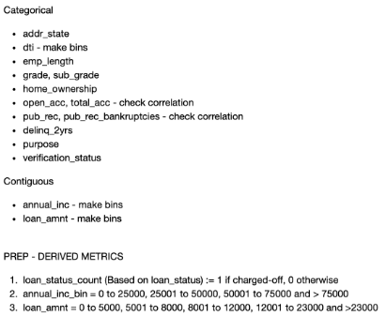
Preparation for Analysis
Columns were categorized as ‘categorical’ or ‘contiguous’
Bins were created for few columns
Columns that needed correlation check were identified

Slide 5
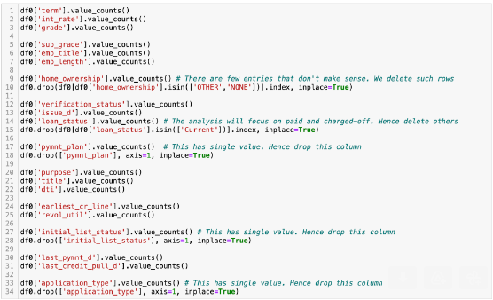
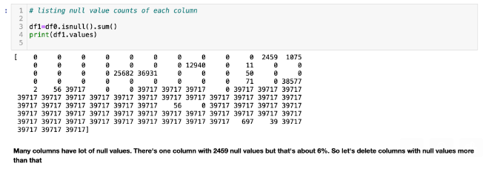

Few Observations from Data Analysis
Column values were analyzed
Lot of columns were null
Correlation was performed

Slide 6
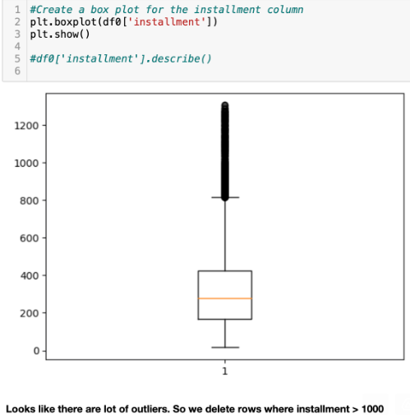
Few Observations from Data Analysis Ctd.
Outliers were identified

Slide 7
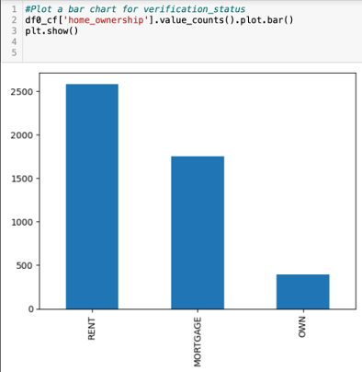
Few Observations of Analysis
People living in rented or mortgaged property tend to default more

Slide 8
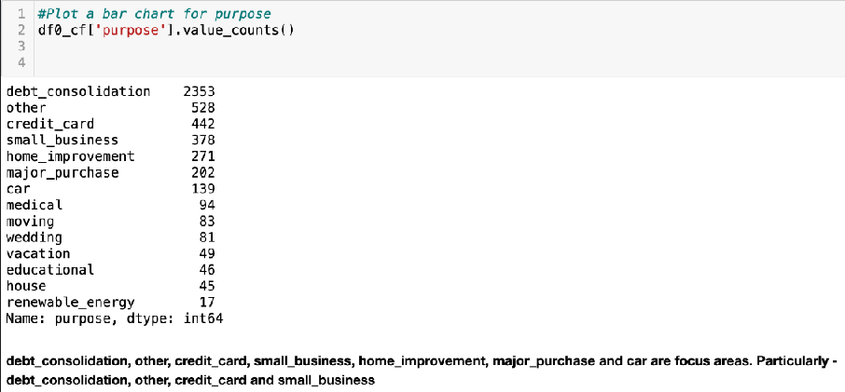
Few Observations of Analysis Ctd.
Does purpose of loan offer important insight?

Slide 9
Conclusion
- Grades B, C and D are more likely to default
- People who own home don't tend to default as mush as others do. But others should be analyzed
- Loans taken for 'debt_consolidation', 'other', 'credit_card' and 'small_business' are more likely to default
- People who have been working for about 5 years or more than 10 years tend to default more on loan. Especially 10+
- People who have 4 to 11 credit lines are more likely to default
- People living in state code CA are more likely to default

